Slide 1
Dijkstra’s Algorithm

Slide 2
Graph Generation
Graph must be connected ( V₁ → V₂ & V₂ → V₃ & V_{n} → V₁ )
4 edges to form Minimum Spanning Tree

Slide 3
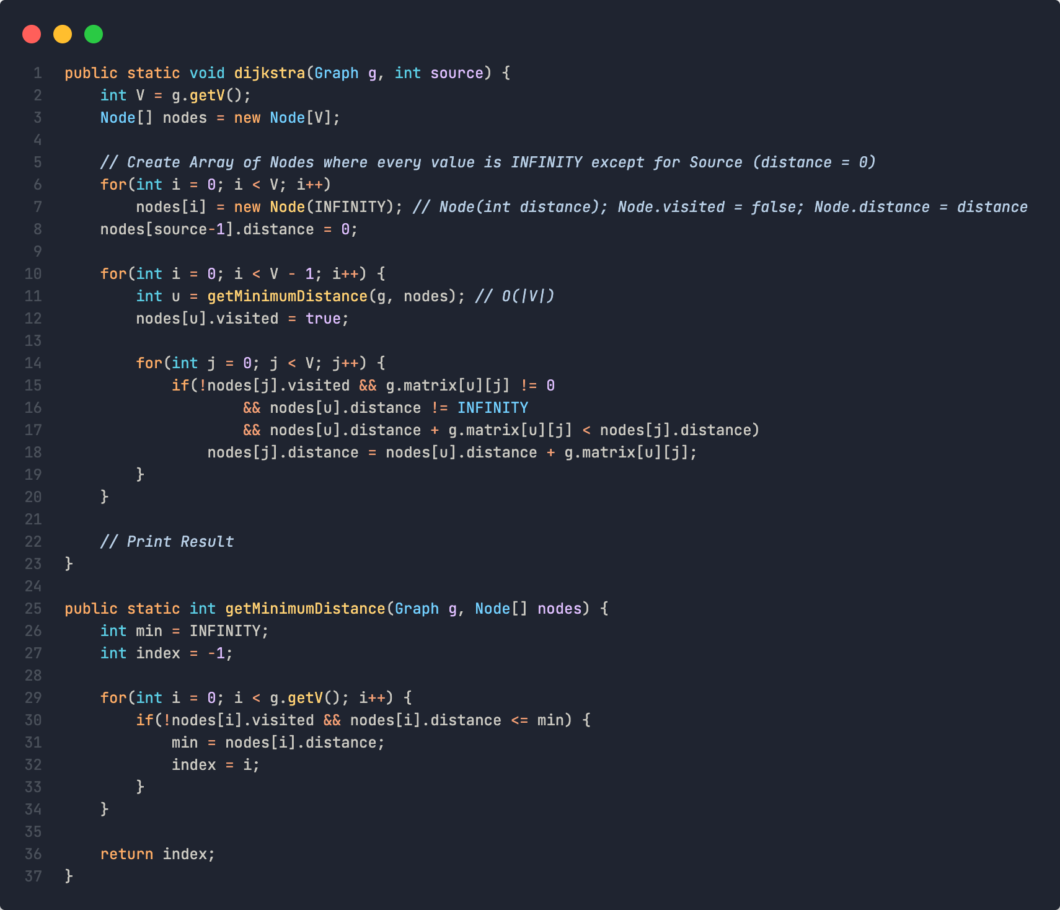



Runtime Complexity
Djikstra’s Algorithm using Array Implementation
Notes:
https://www.codecogs.com/latex/eqneditor.php

Slide 4
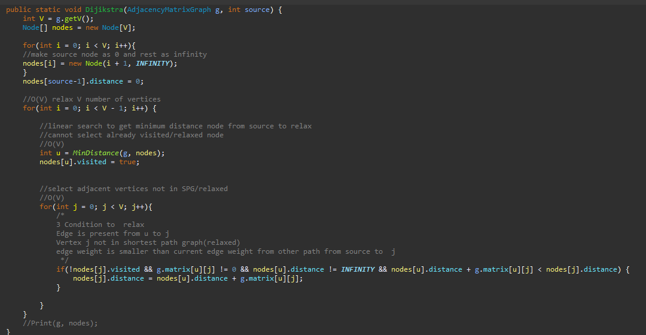
This case
The given graph G is represented as an adjacency matrix.
Priority queue Q is represented as an unordered list.
A[i,j] stores the information about edge (i,j).
Time taken for selecting i with the smallest dist is O(V).
For each neighbor of i, time taken for updating dist[j] is O(1) and there will be maximum V neighbors.
Time taken for each iteration of the loop is O(V) and one vertex is marked as visited/relax
Thus, total time complexity becomes O(V²).

Slide 6
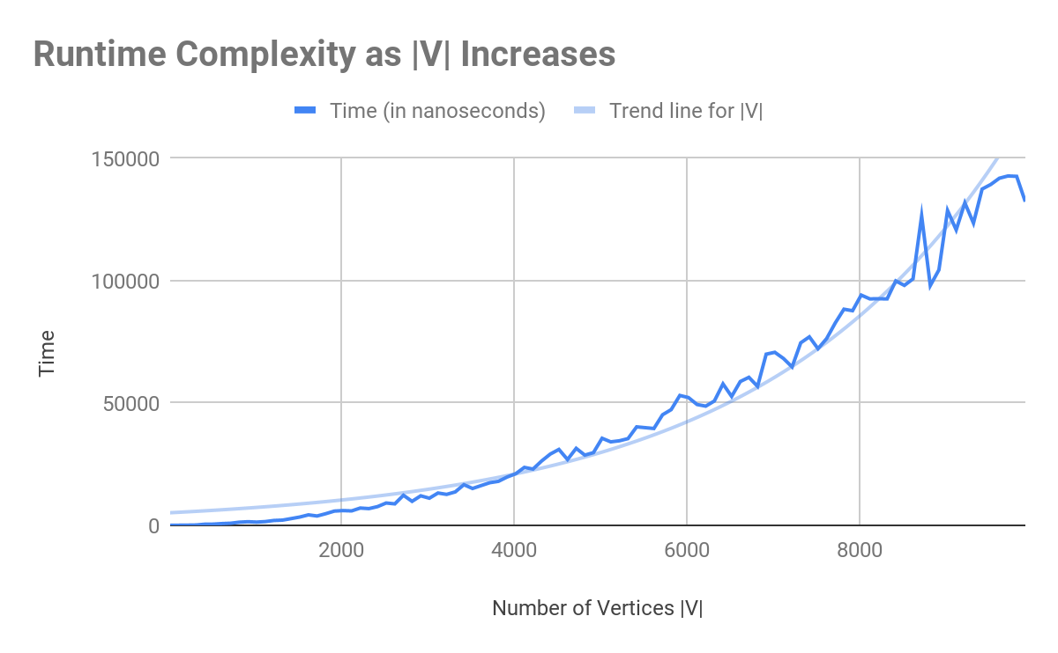
Notes:
The time complexity as |V| rises is exponential (Assume minimum edges for undirected connected graph)

Slide 7
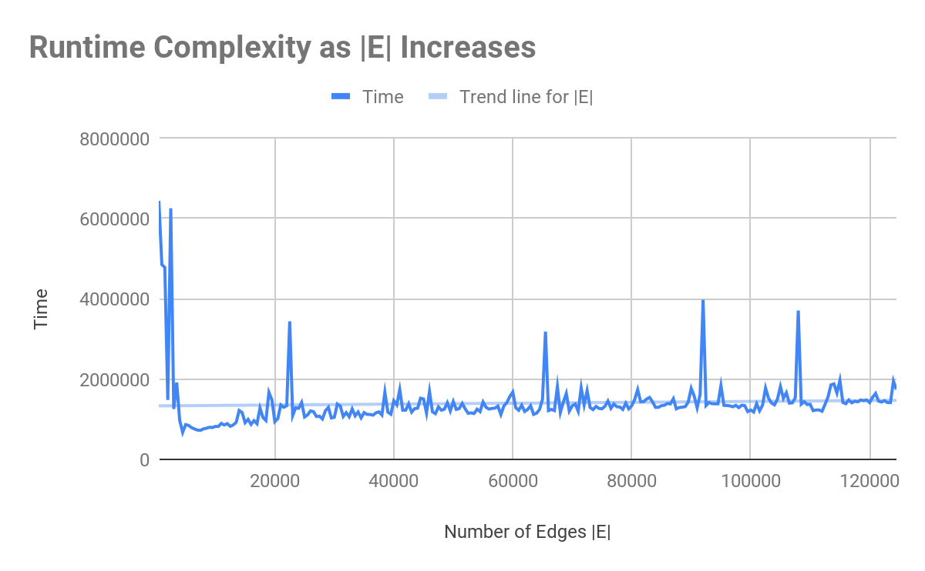
* For |V| = 500
Minimum |E|
Maximum |E|
Notes:
The time complexity as |E| rises remains linear

Slide 8
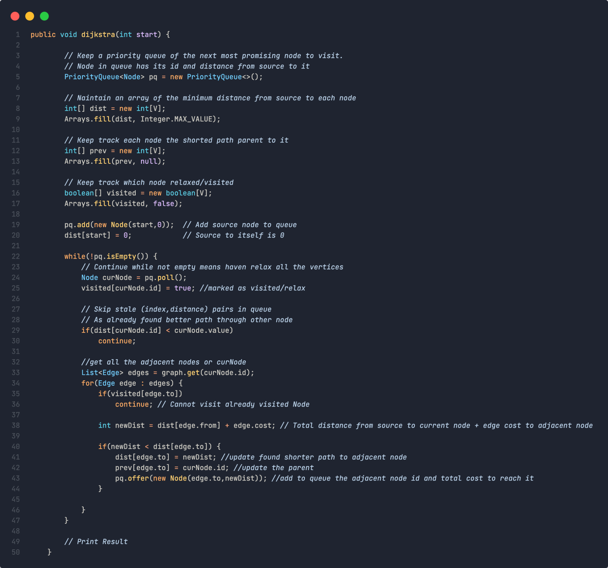
Runtime Complexity
Djikstra’s Algorithm using Priority Queue Implementation
Notes:
https://www.codecogs.com/latex/eqneditor.php

Slide 9
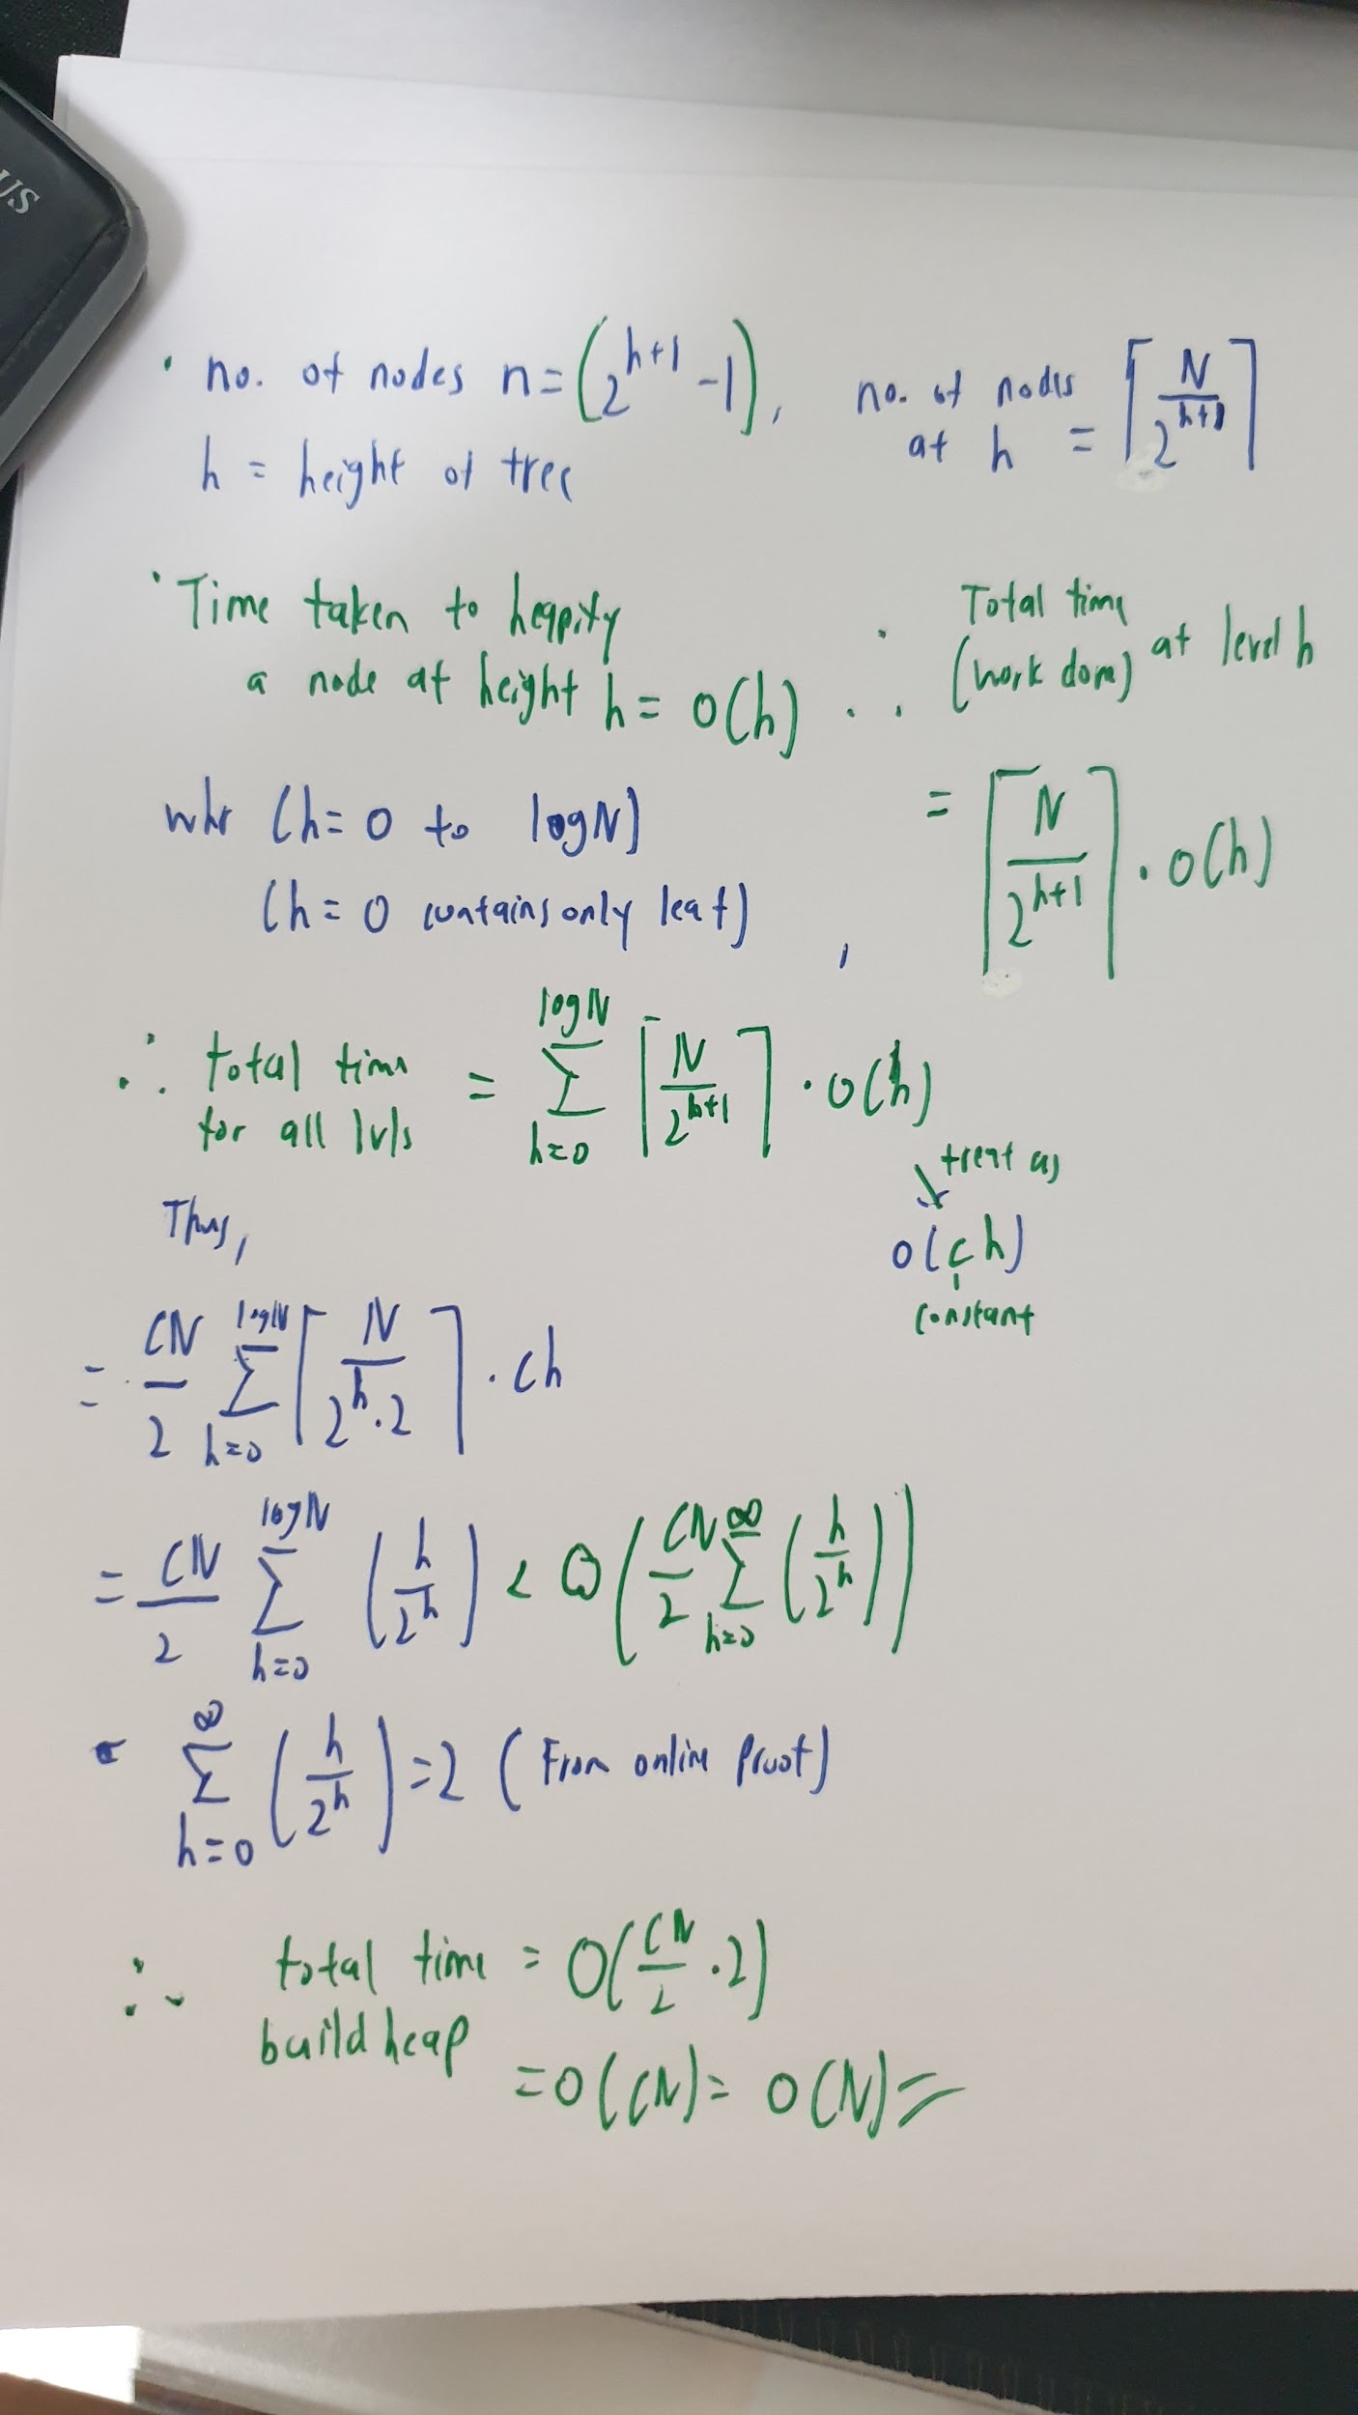
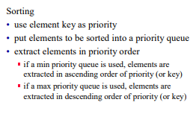
Min Priority Queue
• Collection of elements.
• Each element has a priority or key.
• Supports following operations:
isEmpty O(1)
size add/put an element into the priority queue O(log n)
get element(peek) with min priority O(1)
remove(poll) element with min priority O(log n)
If given collections or array to put in Priority Queue O(n)
N remove min operations and N put operation(swap min element(root) and last leaf node). O(N)
Min-heapify the new root
To keep as a heap O(log N)
Time complexity,
O(N log N)
Both add/poll element from the priority queue need to heapify the head again thus will take O(log n)

Slide 10
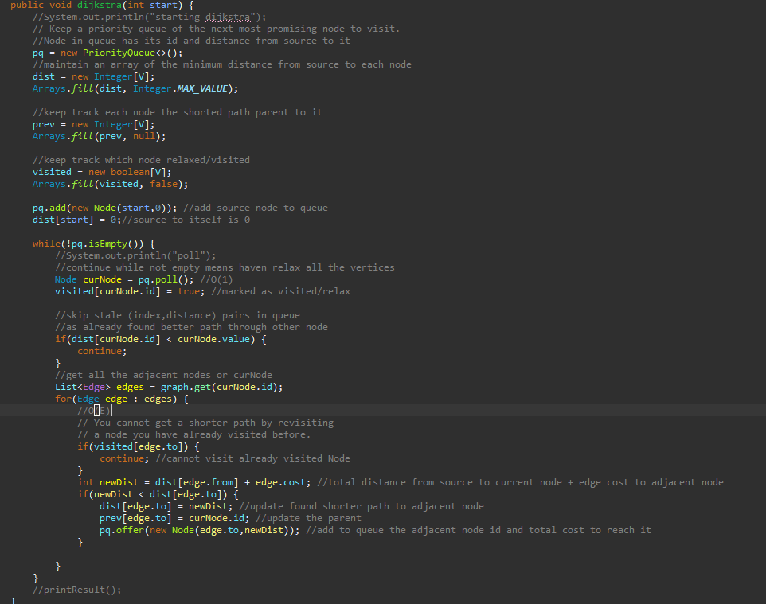
This case
The given graph G is represented as an adjacency list.
Priority queue Q is represented as a binary heap.
In min heap, operations like extract-min and decrease-key value takes O(logV) time.
With adjacency list representation, all vertices of the graph can be traversed using BFS in O(V+E) time.
So, overall time complexity becomes O(E+V) x O(logV) which is O((E + V) x logV) = O(ElogV)

Slide 11
O(for each vertex using min heap: for each edge linearly: push vertices to min heap that edge points to)
V = number of vertices
O(V * (pop vertex from min heap + find unvisited vertices in edges * push them to min heap))
E = number of edges on each vertex
O(V * (pop vertex from min heap + E * push unvisited vertices to min heap)). Note, that we can push the same node multiple times here before we get to "visit" it.
O(V * (log(heap size) + E * log(heap size)))
O(V * ((E + 1) * log(heap size)))
O(V * (E * log(heap size)))
E = V because each vertex can reference all other vertices
O(V * (V * log(heap size)))
O(V^2 * log(heap size))
heap size is V^2 because we push to it every time we want to update a distance(found shorter distance value).-Possible to have duplicate node indices in PQ.Not idea but inserting takes O(logN) much faster than searching O(N) + updating take log(N).No issues if the distance of the Node pollfrom PQ is higher than obtained earlier the no operations than and poll next Node.
O(V^2 * log(V^2))
O(V^2 * 2 * log(V))
O(V^2 * log(V))
V^2 is also a total number of edges, so if we let E = V^2, we will get the O(E * log(V))
Repeating steps
Extract min from PQ
Include selected Node in process Set(visited)
Update all adjacent Node distances

Slide 12
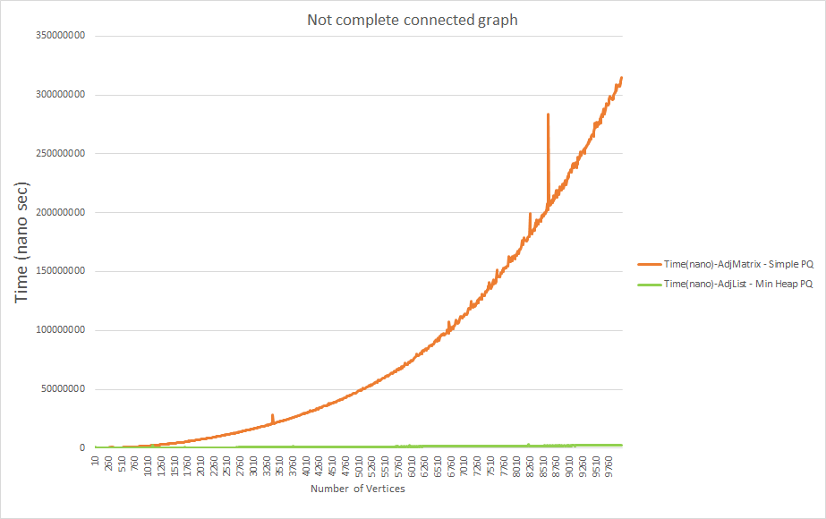
Testing Adj Matrix simple PQ Vs Adj List with Heap PQ

Slide 13
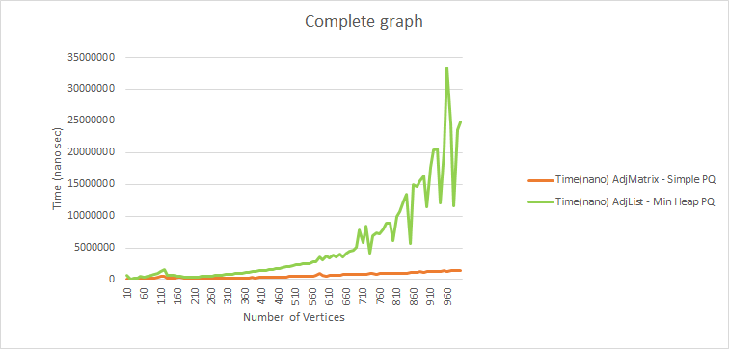
Further testing what if the graph is Strongly connected(very dense)
Adj matrix Vs Adj list

Slide 14




Bounds of the running time of Dijkstra's algorithm on a graph with |E| edges and vertices |V| vertices.
Complexity depends mainly on data structure to represent set Q.
Part(a) Simplest version of Dijkstra's algorithm stores the vertex set Q as an ordinary linked list or array, and extract-minimum is simply a linear search through all vertices in Q.
For sparse graphs, that is, graphs with far fewer than |V|
edges, Dijkstra's algorithm can be implemented more efficiently by storinthe graph in the form of adjacency lists binary heap priority queue to implement extracting minimum efficiently.
If the graph is stored as an adjacency list, the running time for a dense graph where.
V * (V - 1) / 2 edges for strongly complete graph.Time complexity increases to
A dense graph should use adjacency matrix and unsorted priority queue then the total cost is Θ(|V|²). A sparse graph should use an adjacency list and a heap then the total cost is Θ(|E| log |V|) for a connected graph.

Slide 15
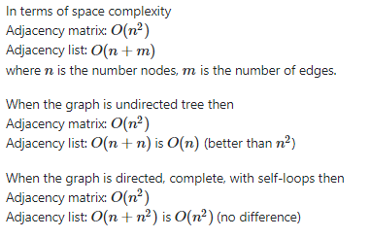
Conclusion from data and finding.
For sparse graph,matrix representation most of the matrix cells remain unused which leads to the waste of memory.
Thus minimise matrix representation for sparse graphs,adjacency list preferred.
If the graph is dense then the number of edges is close to (the complete) n(n - 1) / 2 or n^2 if the graph is directed with self-loops.
No advantage of using adjacency list over matrix.

